Slide 1

Epileptic Seizure Detection from EEG Signal Using Empirical Mode Decomposition and Deep Learning
CSE4000: Project/Thesis
Presented By:
Supervised By:
Dr. Md. Aminul Haque Akhand
Professor
Dept. of Computer Science and Engineering
Khulna University of Engineering & Technology
Shupta Das
Roll:1707001
Suraiya Akter Mumu
Roll: 1707100
Dept. of Computer Science and Engineering
Khulna University of Engineering & Technology

Slide 2
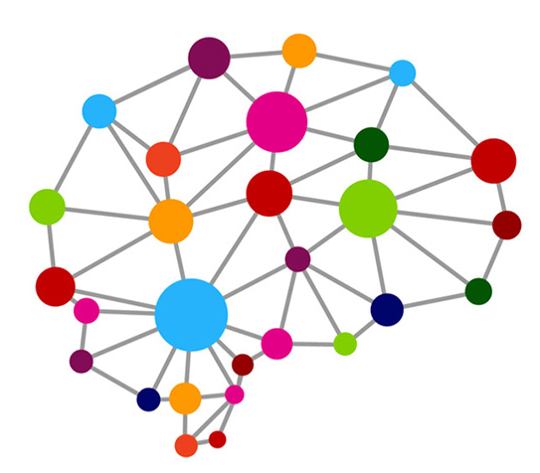

Outline
About Epileptic Seizure
Purpose
Background
Specific Aims
Contributions
Methodology
Result Analysis
Conclusion
Future work

Slide 3
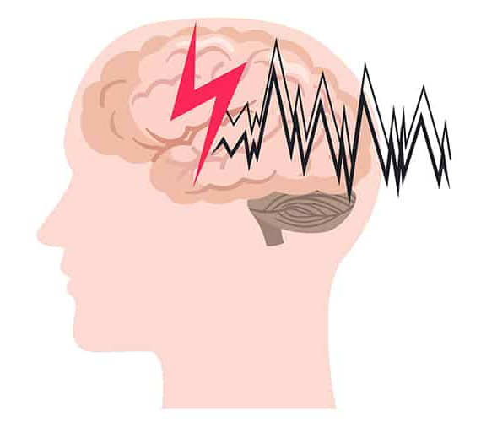

About Epileptic Seizure
Seizure
Abnormal electrical activity in the brain
Causes body movement disorders
Loss of consciousness, stiffness, confusion
Recurrent occurrences of seizure

Slide 4

Purpose
According to the World Health Organization (WHO)
Affects around 50 million people worldwide
70% could live seizure free if properly diagnosed
National prevalence of epilepsy per 1000 was 8.4
Proper diagnosis is a major concern

Slide 5

Background

Slide 6
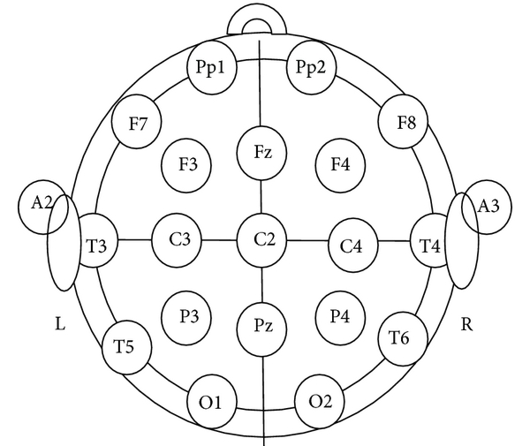
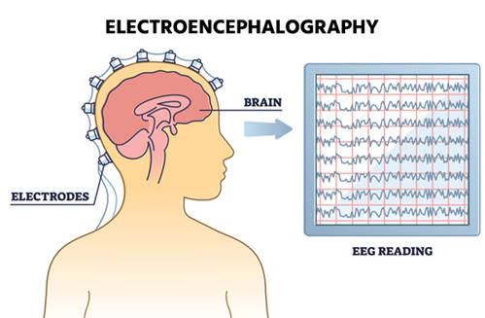
Background
EEG is more useful
Reflect electrical activity of brain
Standard 10-20 system widely used
Capture signals from electrodes
Figure 1: 10-20 system
Difficult to detect seizure by visualizing EEG
Figure 2: EEG data collection

Slide 7
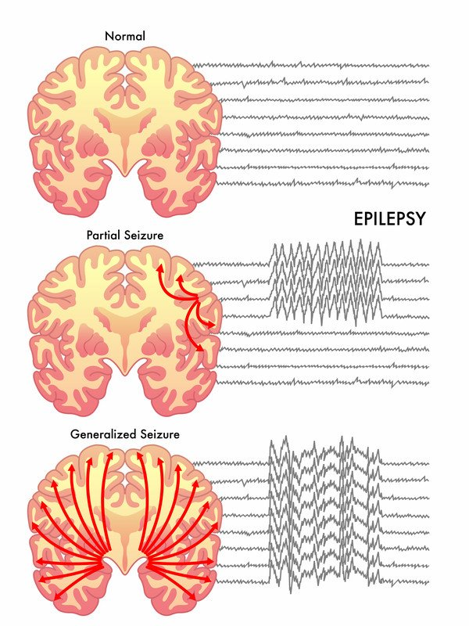
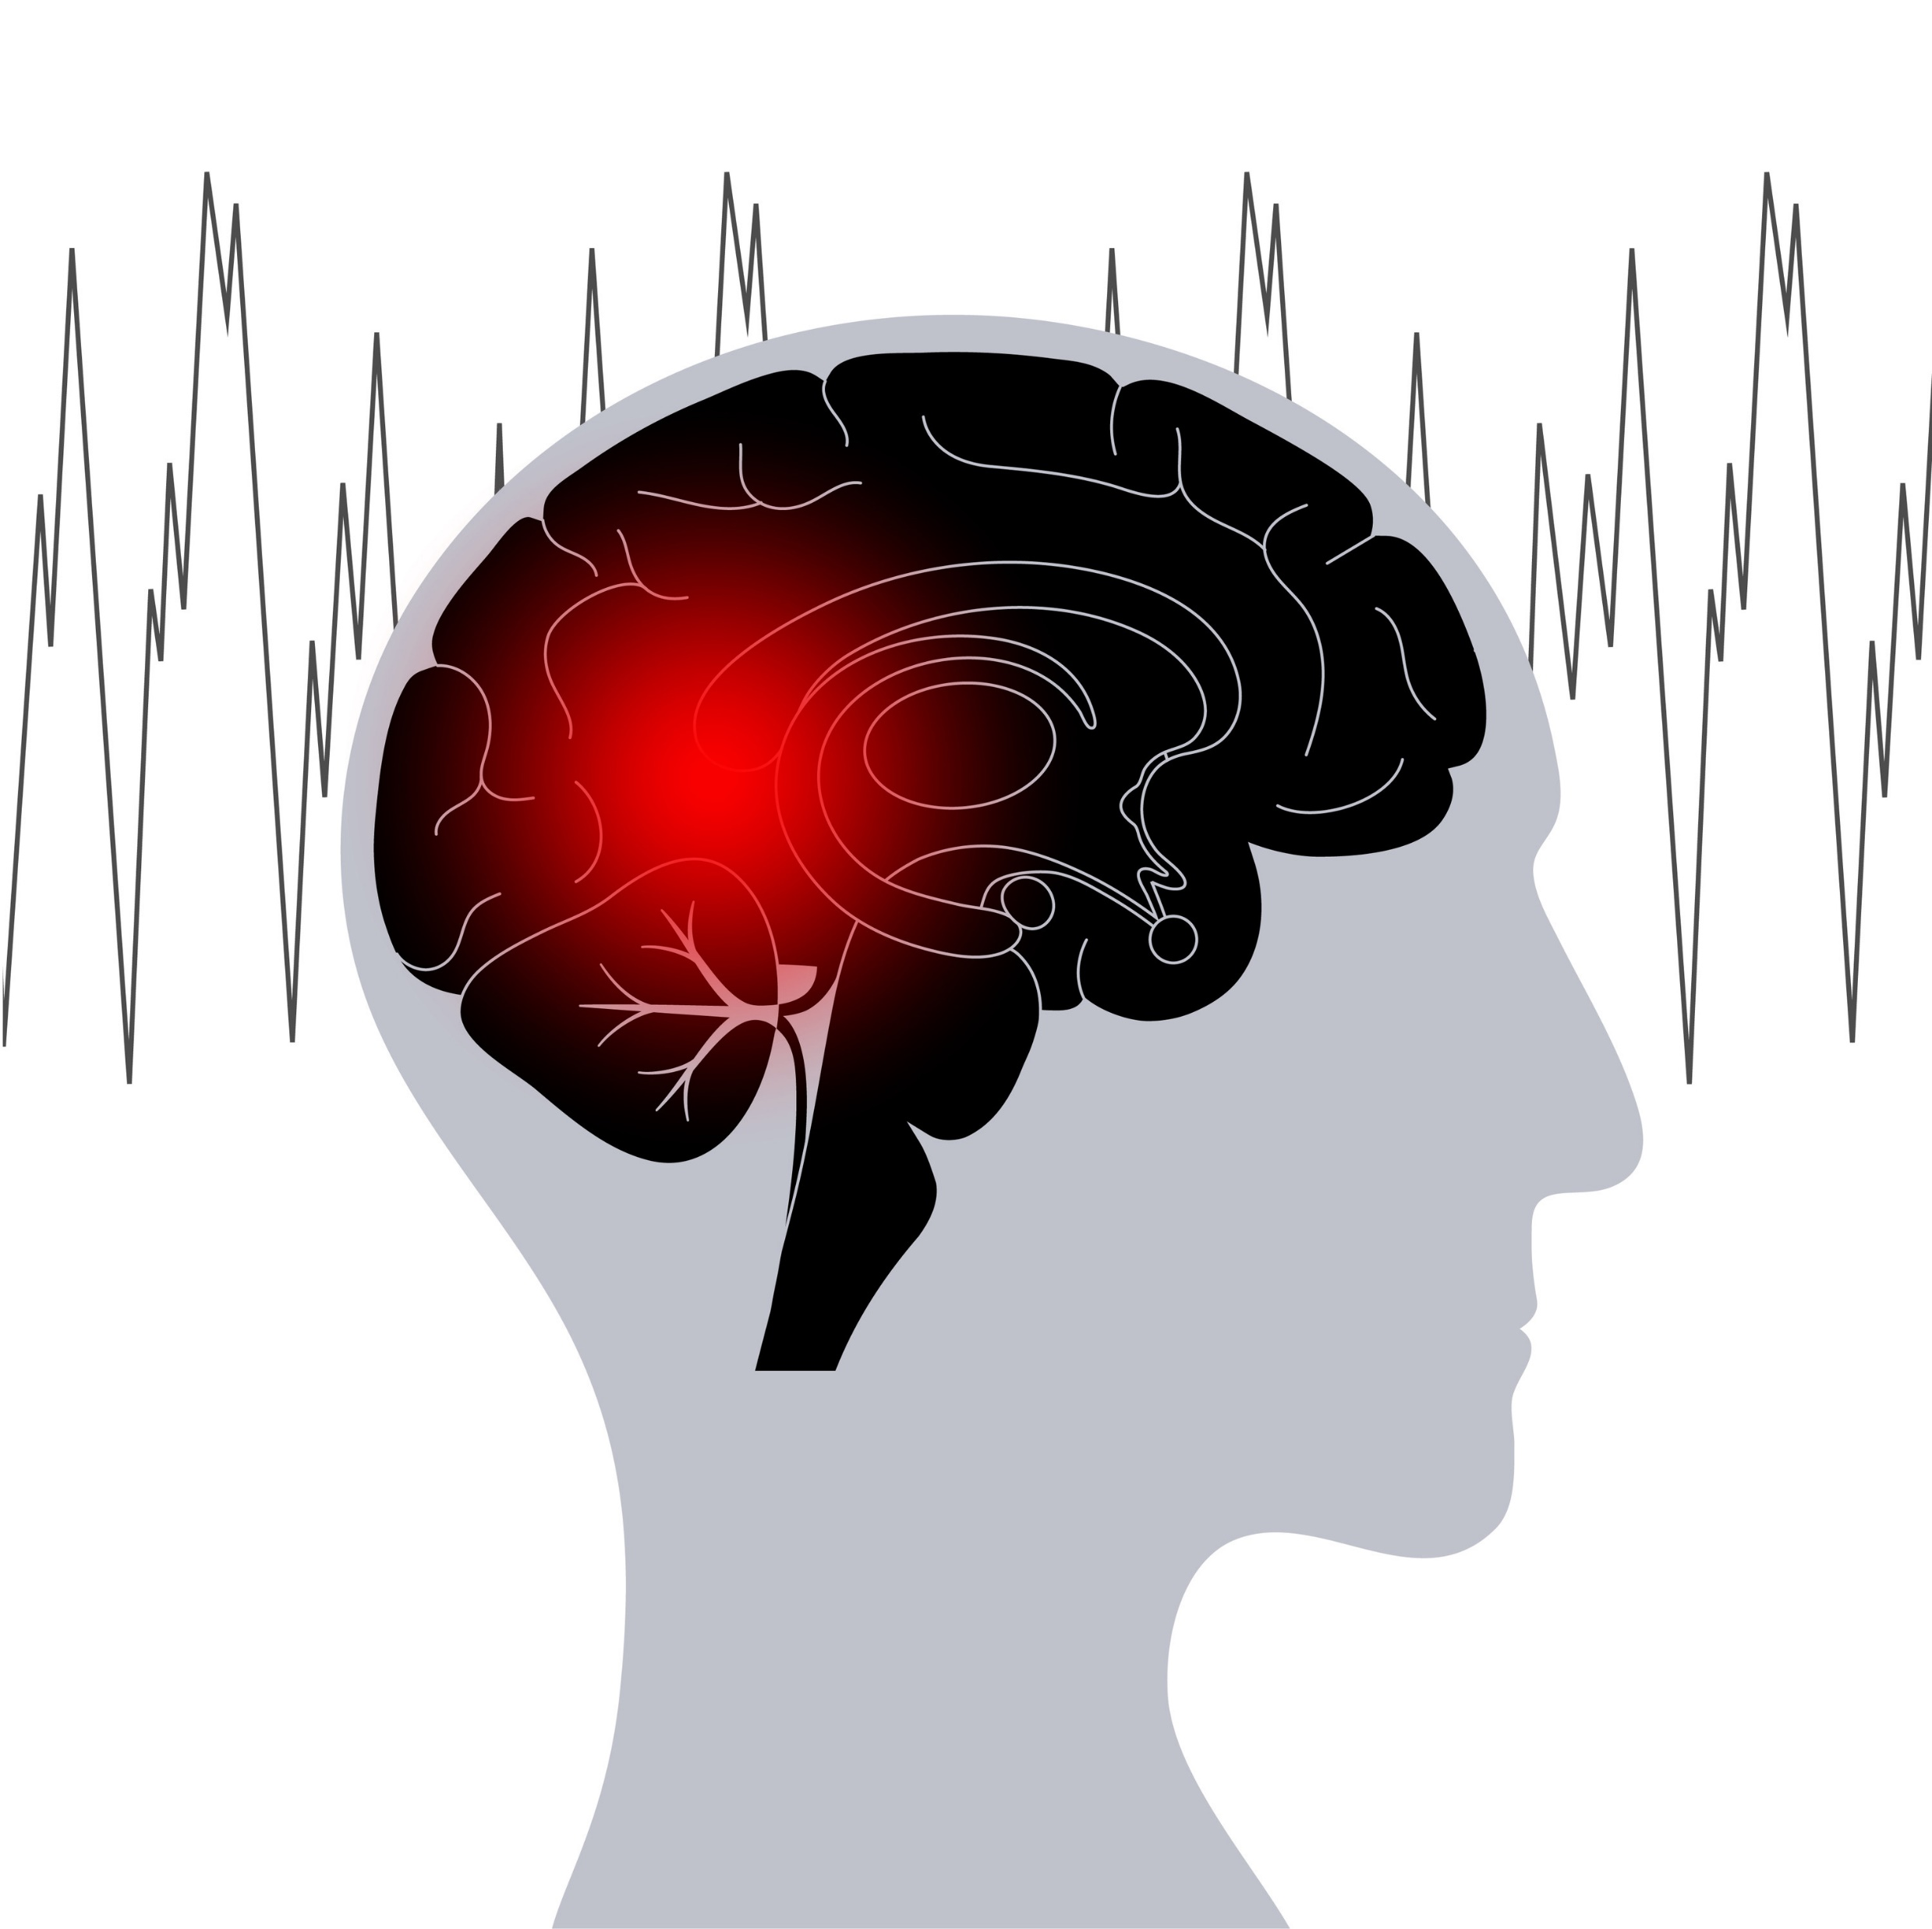
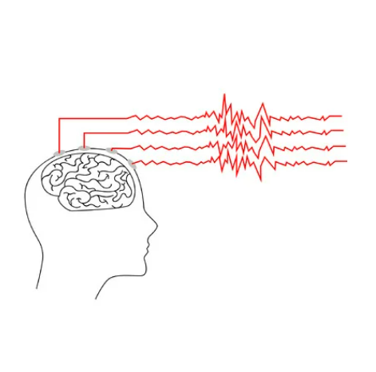
Background (Cont.)
Attention paid in recent years
Seizure detection
Seizure prediction
Non Seizure signal
Feature extraction methods
Feature selection methods
Machine learning and deep learning based method
Seizure signal
Seizure
prediction
Seizure

Slide 8
Literature Review
Table 1: Literature review of related works
Sl. | Title | Work ref. year | Method
1. | Epileptic seizure detection in EEG using mutual information-based best individual feature selection | Hassan et al. 2022[1] | EMD+MIBIF selection+MLPNN
2. | Epileptic seizure detection using cross-bispectrum of electroencephalogram signal | N. Mahmoodian et al. 2019[2] | Window filter cross bispectrum- feature+svm(rbf)
3. | Fuzzy-Based Automatic Epileptic Seizure Detection Framework | Aayesha et al. 2022[3] | DWT +fuzzy logic based algo
4. | Supervised learning in automatic channel selection for epileptic seizure detection | N. D. Truong et al. 2017[4] | ACS+RF

Slide 9
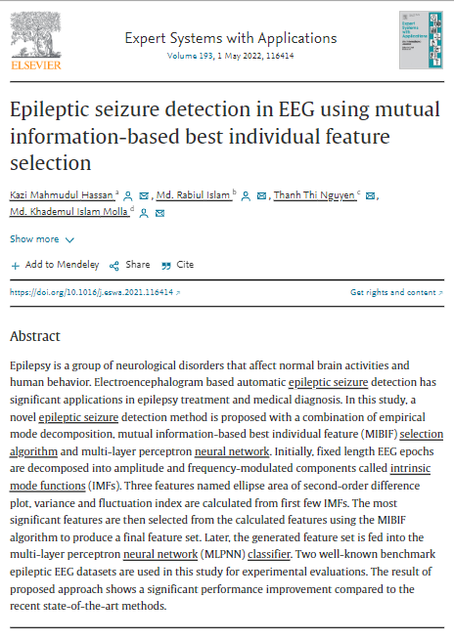
Base Paper
Title : Epileptic seizure detection in EEG using mutual information-based best individual feature selection
DOI of the paper: 10.1016/j.eswa.2021.116414
Journal: Expert Systems with Applications
Volume: 193

Slide 10
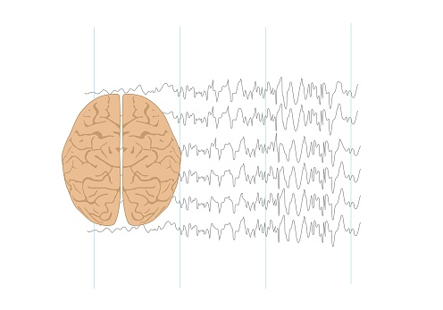
Specific Aims
The study aims
To detect seizure using EEG
Computer intelligence based detection
Measure the generalization
Seizure
Non seizure

Slide 11

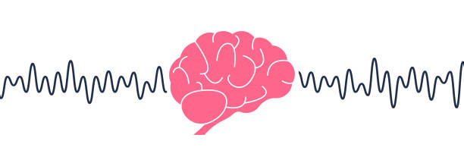
Contributions
Collection of Local Data
Provided by Dr. Abdus Salam
Neurology & Epilepsy Specialist,
Shaheed Shaikh Abu-Naser Specialized Hospital,Khulna
Process local data
Information

Slide 12
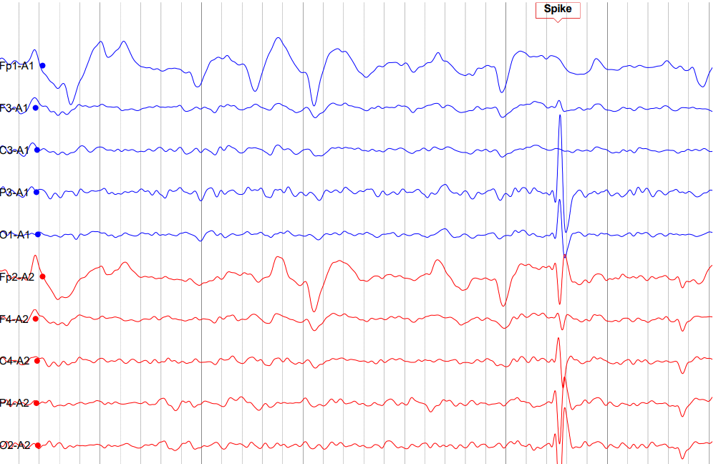
Local Dataset
Recorded in .e (Nicolet) format
19 bipolar EEG channels
“Fp1-A1”, “F3-A1”, “C3-A1”, “P3-A1”, “O1-A1”, “Fp2-A2”, “F4-A2”, “C4-A2”, “P4-A2”, “O2-A2”, “F7-A1”, “T3-A1”, “T5-A1”, “F8-A2”, “T4-A2”, “T6-A2”, “Fz-A1”, “Cz-A1”, “Pz-A1”
Additional signals like “ECG-Bipolar”, and “Photic”
Frequency of 500 samples per second
Figure 3: A small portion of local dataset containing spike

Slide 13

Methodology

Slide 14
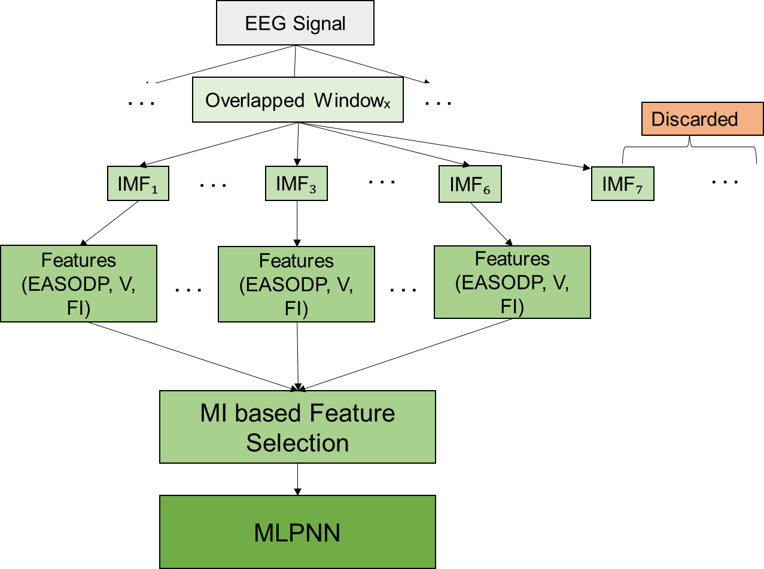
Methodology
Figure 4: Overall methodology

Slide 15

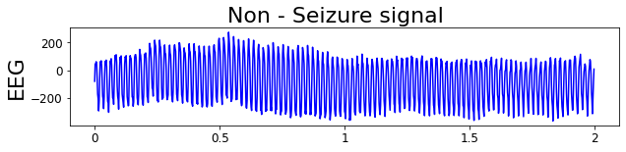
Methodology(Cont.)
Two datasets were used
CHB-MIT: available in https://physionet.org/content/chbmit/1.0.0/
Local Dataset : converted using MATLAB toolbox eeglab2021.1
`
Data collection
Fp1-A1
Figure 5 : EEG Recording of a channel
Additional signals like “ECG-Bipolar” and “Photic” are ignored in local data

Slide 16
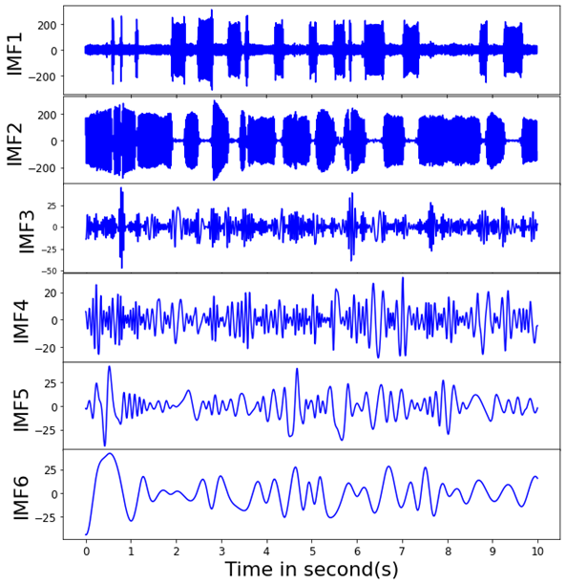
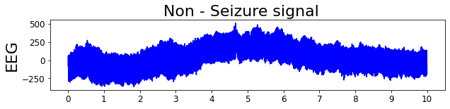
Methodology(Cont.)
10 second and 5 second segmentation
Empirical Mode Decomposition based 6 IMFs
Data collection
Signal Preprocessing
Signal Separation
Segmentation
EMD
Decomposition
10 second EEG signal
Figure 6: Empirical Mode Decomposition

Slide 17
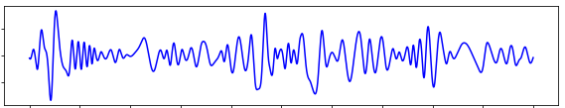
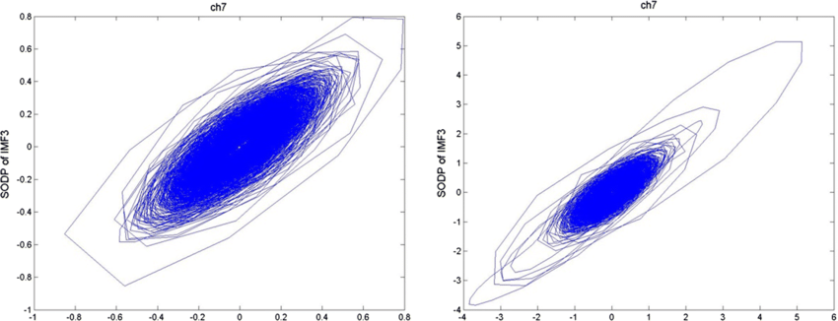
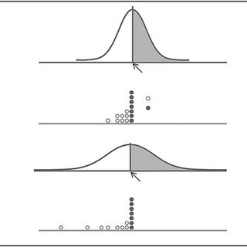
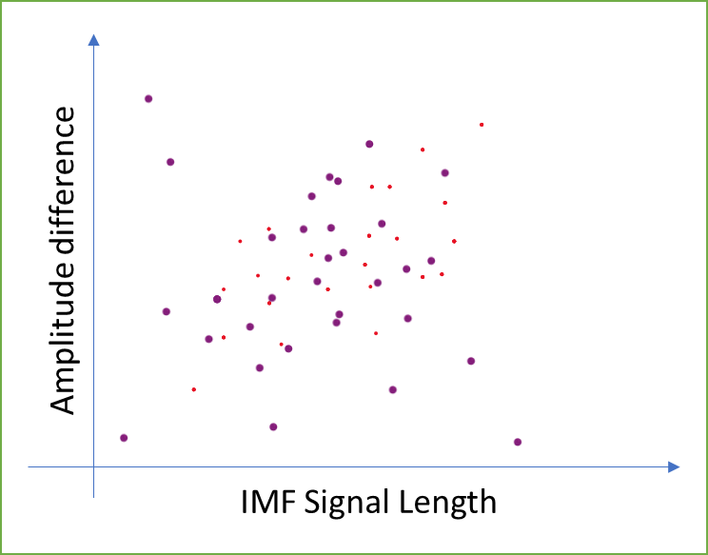
Methodology(Cont.)
3 features are extracted
Ellipse Area of SODP
Variance
Fluctuation Index
Data collection
Signal Preprocessing
IMF
Feature Extraction
a
b
a
b
SODP Plot
Variance
Fluctuation Index

Slide 18

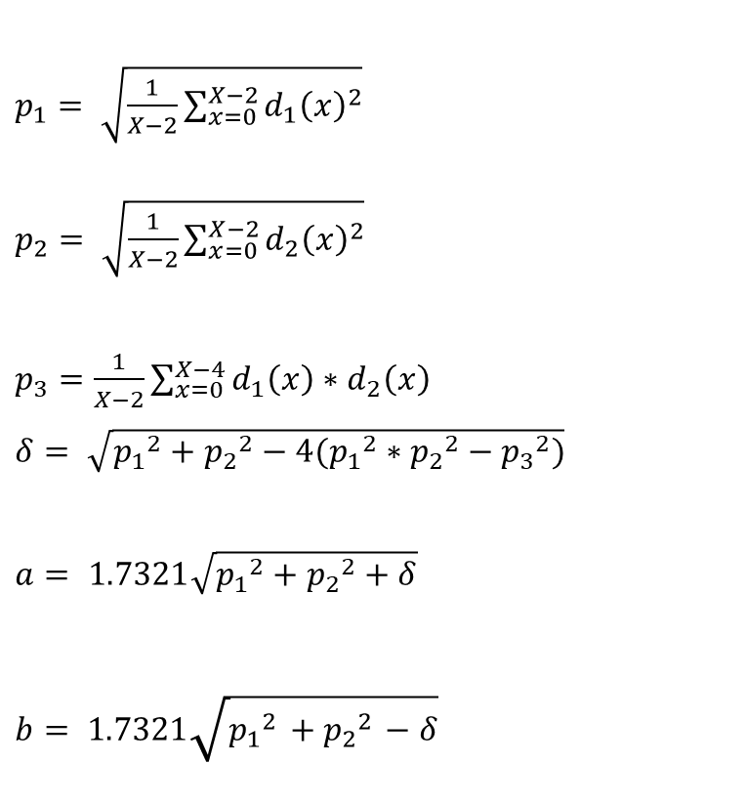
Ellipse area of SODP
$p_{1}= \sqrt{\frac{1}{X−2}\sum_{x=0}^{X−2}{{d_{1}\left(x\right)}^{2}}}$
$p_{2}= \sqrt{\frac{1}{X−2}\sum_{x=0}^{X−2}{{d_{2}\left(x\right)}^{2}}}$
$p_{3}=\frac{1}{X−2}\sum_{x=0}^{X−4}{d_{1}\left(x\right)∗d_{2}\left(x\right)}$
$δ= \sqrt{{p_{1}}^{2}+{p_{2}}^{2}−4({p_{1}}^{2}∗{p_{2}}^{2}−{p_{3}}^{2})}$
$a= 1.7321\sqrt{{p_{1}}^{2}+{p_{2}}^{2}+δ}$
$b= 1.7321\sqrt{{p_{1}}^{2}+{p_{2}}^{2}−δ}$
a compact representation of the variability and spread of the data.
$d_{1}\left(x\right)=s_{i}\left(x+1\right)−s_{i}\left(x\right)$
$$d_{2}\left(x\right)=s_{i}\left(x+2\right)−s_{i}\left(x−1\right)$$
$${Area}_{ellipse}= πab$$

Slide 19

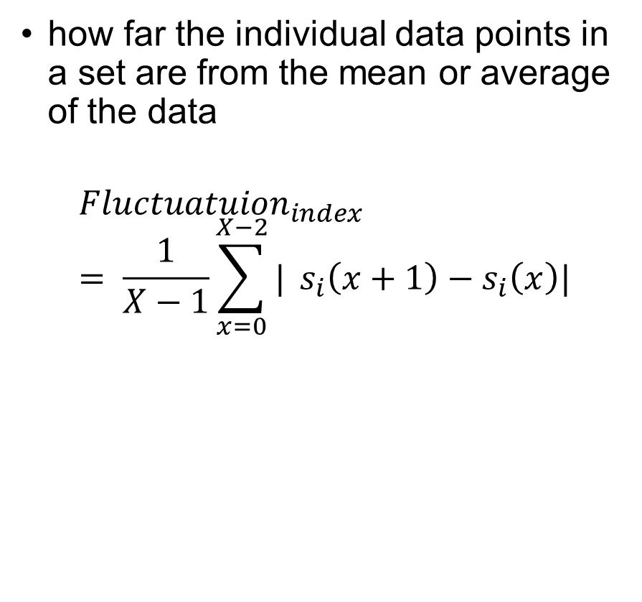
Fluctuation Index
Variance
how far the individual data points in a set are from the mean or average of the data
how far the individual data points in a set are from the mean or average of the data
$${Fluctuatuion}_{index}= \frac{1}{X−1}\sum_{x=0}^{X−2}{|} s_{i}\left(x+1\right)−s_{i}\left(x\right)|$$
$Variance=\frac{\sum_{x=0}^{X−1}{ {(s_{i}\left(x\right)−μ)}^{2}}}{X−1}$

Slide 20
Methodology(Cont.)
Mutual Information Based feature selection
Select best ranked features according to larger MI score
Reduce computational demands
Data collection
Signal Preprocessing
f1 | f2 | f3 | f4 | f5 | f6 | f7 | f8 | ……… | fn
Feature Extraction
Feature Selection
f1 | f2 | f3 | f4 | f5 | f6 | f7 | f8 | ……… | fn
f1 | f3 | f4 | f6 | f7 | ……… | fn
Best n-3 features
Figure 7: Feature Selection

Slide 21
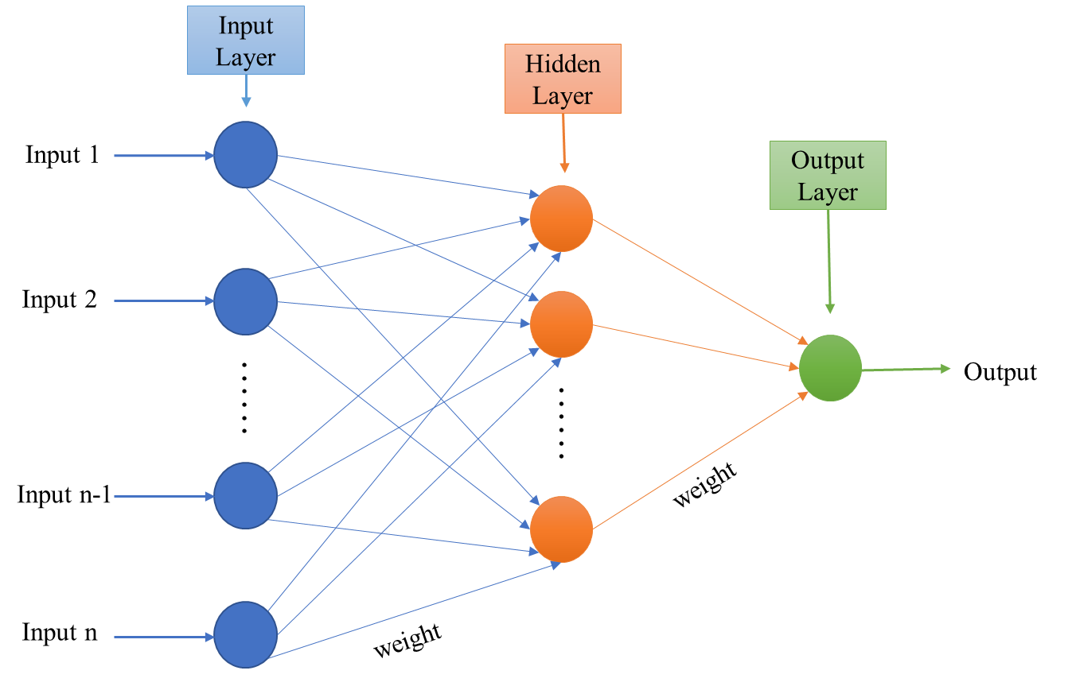
Methodology(Cont.)
Multilayer Perceptron Neural Network (MLPNN) to classify
Single hidden layer
tanh activation function
Learning rate 0.001
Data collection
Signal Preprocessing
Feature Extraction
Feature Selection
Classification Model
Seizure or Non-seizure
Figure 8: Basic structure of MLPNN

Slide 22

Result Analysis

Slide 23
Result Analysis
Table 2: Performance analysis on CHB-MIT dataset (without feature selection)
Fold | (Hidden neuron=10) | (Hidden neuron=50)
5 | 98.98 | 99.19
10 | 99.19 | 99.59
Figure 9: Loss Vs. Epoch curves on CHB-MIT dataset
Total case 23

Slide 24
Result Analysis
Table 3: Performance analysis on CHB-MIT dataset (with feature selection)
Fold | MLPNN
 | 10 hidden neurons |  | 50 hidden neurons
 | Feature no. | Accuracy | Feature no. | Accuracy
5 | 275 | 99.73 | 210 | 99.79
10 | 279 | 100.0 | 314 | 99.19
Figure 10: Loss Vs. Epoch curves on CHB-MIT dataset

Slide 25
Result Analysis (Cont.)
Table 3: Performance analysis on CHB-MIT dataset (with feature selection)
5-Fold Cross-Validation:
Best Result: 99.79 % with 210 Features and 50 hidden neurons.
10-Fold Cross-Validation:
Highest Accuracy: 100.0% with 279 Features and 10 hidden neurons
Fold | MLPNN
 | 10 hidden neurons |  | 50 hidden neurons
 | Feature no. | Accuracy | Feature no. | Accuracy
5 | 275 | 99.73 | 210 | 99.79
10 | 279 | 100.0 | 314 | 99.19
Model do better performance with selected feature

Slide 26
Result Analysis (Cont.)
Table 4: Performance analysis on local dataset(without feature selection)
Fold | (Hidden neuron=10) | (Hidden neuron=10)
5 | 100 | 100
10 | 100 | 100
Figure 11: Loss Vs. Epoch curves on local dataset
Total case 2

Slide 27
Result Analysis (Cont.)
Table 5: Performance measure on local dataset (with feature selection)
Fold | MLPNN
 | 10 hidden neurons |  | 50 hidden neurons
 | Feature no. | Max Accuracy | Feature no. | Max Accuracy
5 | 233 | 100 | 200 | 100
10 | 206 | 100 | 201 | 100
Figure 12: Loss Vs. Epoch curves on local dataset

Slide 28
Result Analysis (Cont.)
Table 6: Performance analysis using two dataset(without feature selection)
Fold | Hidden neuron=10 | Hidden neuron=50
5 | 90.625 | 93.75
10 | 84.375 | 93.75
5-fold and 10-fold cross-validation: achieving maximum accuracy of 93.75%
MLPNN with 50 hidden neurons outperforms MLPNN with 10 hidden neurons

Slide 29
Result Analysis (Cont.)
Table 7: Performance analysis using two dataset(with feature selection)
Fold | MLPNN
 | 10 hidden neurons |  | 50 hidden neurons
 | Feature no. | Accuracy | Feature no. | Accuracy
5 | 275 | 65.265 | 210 | 62.5
10 | 279 | 87.5 | 314 | 90.625
10-Fold evaluation with 50 neurons shows best accuracy score of 90.825%"
MLPNN with more features is more accurate

Slide 30
Result Analysis (Cont.)
Table 8: Comparison with other studies on seizure non-seizure detection
Sl. | Title | Work ref. year | Method | Result
1. | Automatic seizure detection based on imaged‑EEG signals through fully convolutional networks | C. Gómez et al.[5] | CNN | 99.3%
2. | An EEG based real-time epilepsy seizure detection approach using discrete wavelet transform and machine learning methods | Shen et al. 2022[6] | DWT+SVM | 97%
3. | A Convolutional Neural Network for Seizure Detection | O. Kaziha et al 2020[7] | CNN | 96.74%
4. | Epileptic Seizure Detection Based on Bidirectional Gated Recurrent Unit Network | Y. Zhang et al. 2022[8] | DWT+Temporal, spectral features | 92.79%
5. | Our work | -- | EMD+MI based feature selection+MLPNN | 5 fold : 99.79% 10 fold: 100.0%

Slide 31

Conclusion

Slide 32

Conclusion
EMD based nonlinear and nonstationary features are analyzed
Large scale local data needed for convenience
Misclassification occurs due to
Age differences
Similarity in seizure and non-seizure
Varying range of signals of patients

Slide 33

Future work
Some scopes of work
Integration of EEG with other signals like ECG
Personalized seizure detection on local dataset
Processing with large scale local dataset

Slide 34
Thank You

Slide 35
References
Hassan, K.M., Islam, M.R., Nguyen, T.T. and Molla, M.K.I., 2022. Epileptic seizure detection in EEG using mutual information-based best individual feature selection. Expert Systems with Applications, 193, p.116414.
Mahmoodian, N., Boese, A., Friebe, M. and Haddadnia, J., 2019. Epileptic seizure detection using cross-bispectrum of electroencephalogram signal. seizure, 66, pp.4-11.
Bilal Qureshi, M., Afzaal, M., Shuaib Qureshi, M. and Gwak, J., 2022. Fuzzy-based automatic epileptic seizure detection framework. Computers, materials & continua, 70(3), pp.5601-5630.
Truong, N.D., Kuhlmann, L., Bonyadi, M.R., Yang, J., Faulks, A. and Kavehei, O., 2017. Supervised learning in automatic channel selection for epileptic seizure detection. Expert Systems with Applications, 86, pp.199-207.
Gómez, C., Arbeláez, P., Navarrete, M., Alvarado-Rojas, C., Le Van Quyen, M. and Valderrama, M., 2020. Automatic seizure detection based on imaged-EEG signals through fully convolutional networks. Scientific reports, 10(1), pp.1-13.
Shen, M., Wen, P., Song, B. and Li, Y., 2022. An EEG based real-time epilepsy seizure detection approach using discrete wavelet transform and machine learning methods. Biomedical Signal Processing and Control, 77, p.103820.

Slide 36
References(Cont.)
Kaziha, O. and Bonny, T., 2020, February. A convolutional neural network for seizure detection. In 2020 Advances in Science and Engineering Technology International Conferences (ASET) (pp. 1-5). IEEE.
Zhang, Y., Yao, S., Yang, R., Liu, X., Qiu, W., Han, L., Zhou, W. and Shang, W., 2022. Epileptic seizure detection based on bidirectional gated recurrent unit network. IEEE Transactions on Neural Systems and Rehabilitation Engineering, 30, pp.135-145.

